Slide 1
Principles of MVC For rails Developers
View Ruby On Rails Course at: www.edureka.co/ruby-on-rails
For Queries:
Post on Twitter @edurekaIN: #askEdureka
Post on Facebook /edurekaIN
For more details please contact us:
US : 1800 275 9730 (toll free)
INDIA : +91 88808 62004
Email Us : webinars@edureka.co

Slide 2
Objectives
At the end of this module, you will be able to understand:
Challenges Faced when Designing an Application Without Framework
MCV Design Patterns
Logic Behind MVC
DRY and Convention Over Configuration
MVC Benefits
Demo on MVC in RAILS

Slide 3


Challenges Faced when Designing an Application without a Framework
Complexity in direct coding
Everything must be tested, which is difficult
Difficult to re-use code
Hard code everything from scratch
Teamwork challenges - parallel programming cannot be done efficiently

Slide 4
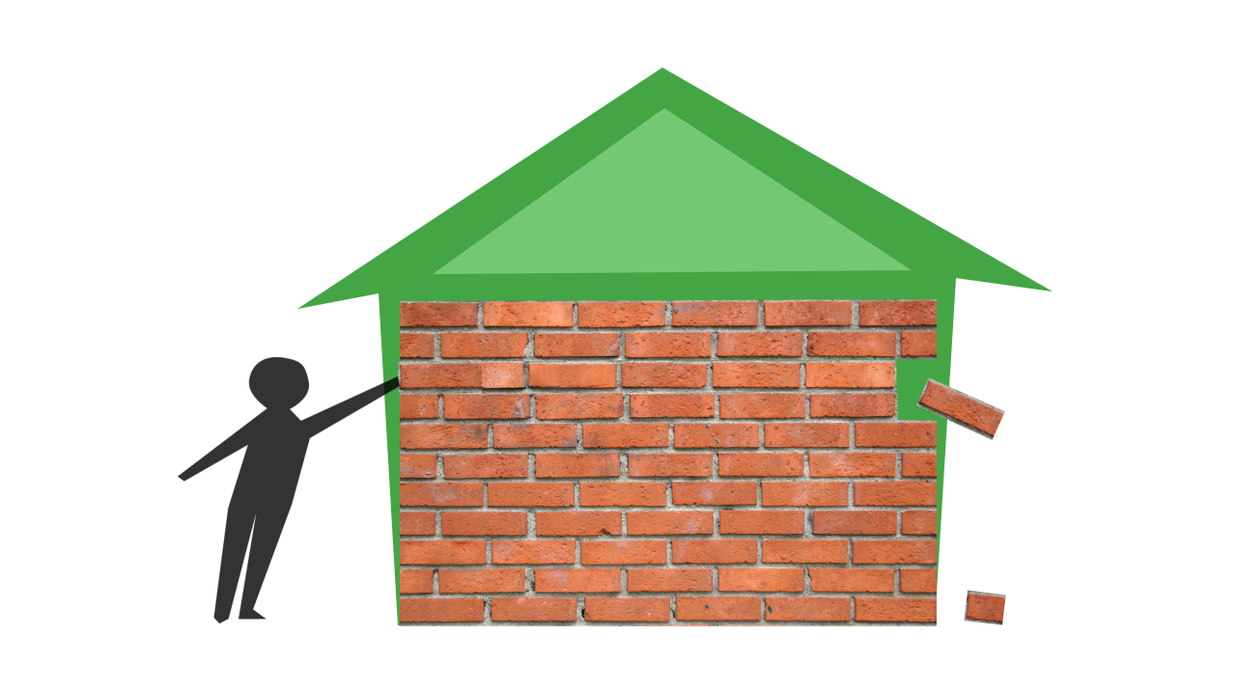

Challenges Faced when Designing an Application without a Framework
Leads to disorganization
Change one thing, break another

Slide 5
The Solution is to use Design Patterns
Design Patterns is the way to organize a program in a proper manner
One such design pattern is MVC

Slide 6
MVC Introduction
Introduction – What is MVC
MVC is acronym for Model-View-Controller
A software design pattern for developing web and desktop applications
In simple words, a better way of separating the logic of your application from the display.

Slide 7
MVC Introduction
Originally described in terms of a design pattern for use with Smalltalk by Trygve Reenskaug in 1979.
His paper was published under the title "Applications Programming in Smalltalk-80: How to use Model-View-Controller", and paved the groundwork for most future MVC implementations.
MVC design pattern is used to separate an application’s data, business logic, and presentation; doing so facilitates the creation of more maintainable, reusable, and testable code.
Model - Data Layer
View - User Interface Layer
Controller - Interacts with the Model

Slide 8

MVC - Illustration
Data object Request
HTTP Request
CONTROLLER
Web Browser/Client
MODEL
Data Objects Response
HTTP Response
Handled by Framework (Hidden from user)
Raw Data Response
Database Request
Events (GET/POST)
Render data
Database
http://www.mywebsite.com
VIEW
Website User
MVC Container

Slide 9
MVC - Data Layer
Model
Data access routines and some business logic can be defined in the model.
Model is responsible for providing the data from the database and saving the data into the data store.
Models are active representations of database tables: they can connect to your database, query it (if instructed to do so by a controller) and save data to the database.
No interaction between models and views: all the logic is handled by controllers.

Slide 10
MVC - User Interface Layer
View
Views define exactly what is presented to the user.
It collects data from the user and gives it to controller and controller invokes the required model.
Controllers pass data to each view to render in some format.
Views can be described as template files that present their content to the user: variables, arrays and objects that are used in views are registered through a controller.
Views should not contain complex business logic; only the elementary control structures necessary to perform particular operations, such as the iteration of collected data through a foreach construct, should be contained within a view.

Slide 11
MVC - Interacting With Model
Controller
Controllers bind the whole pattern together.
Controller is intermediary between View and Model.
Controllers contain the logic of your application.
Each controller can offer different functionality; controllers retrieve and modify data by accessing database tables through models; and they register variables and objects, which can be used in views.
Once request is received from client it executes the appropriate business logic from the model, decide which view to display based on the user's request and other factors, pass along the data that each view will need, or hand off control to another controller entirely.

Slide 12
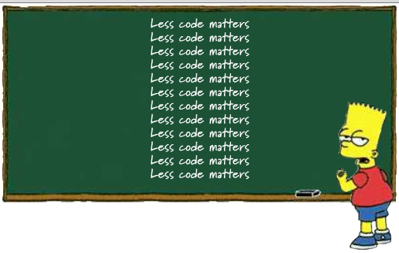
DRY
DRY just means "Don't Repeat Yourself". Make sure that when you write code, you only write it one time.
The DRY principle is stated as "Every piece of knowledge must have a single, unambiguous, authoritative representation within a system."
Reference: https://maurits.wordpress.com

Slide 13

Convention Over Configuration
Convention over configuration (also known as coding by convention) is a software design paradigm which seeks to :
For example, if there is a class Sale in the model, the corresponding table in the database is called "sales" by default. It is only if one deviates from this convention, such as calling the table "product sales", that one needs to write code regarding these names.
Decrease number of decisions on developers
Gain Simplicity
Not losing flexibility

Slide 14
MVC Benefits
Separation of Concerns
Highly Organized and Maintainable
Change Accommodation
Multiple View Support
Parallel development by separate teams

Slide 15
Creating a Rails Application
Rails application can be created using the following command
>rails new app_name
When you create an application using the rails helper script, you can see that a new directly structure is created for your application. The directory structure will have to following directories that will be explained in the next slide.

Slide 16
Directory Layout
File /Folder | Purpose
app/ | Contains the controllers, models, views, helpers, mailers and assets for your application.
bin/ | Contains the rails script that starts your app and can contain other scripts you use to deploy or run your application.
config/ | Configure your application's routes, database, and more
condig.ru | Rack configuration for Rack based servers used to start the application.
db/ | Contains your current database schema, as well as the database migrations
Gemfile Gemfile.lock | These files allow you to specify what gem dependencies are needed for your Rails application. These files are used by the Bundler gem.
Lib/ | Extended modules for you application
Log/ | Application log files

Slide 17
Directory Layout (Contd.)
File /Folder | Purpose
public/ | The only folder seen by the world as-is. Contains static files and compiled assets.
Rakefile | This file locates and loads tasks that can be run from the command line. Rather than changing Rakefile, you should add your own tasks by adding files to the lib/tasks directory of your application
README.rdoc | This is a brief instruction manual for your application. You should edit this file to tell others what your application does, how to set it up, and so on.
test/ | Unit tests, fixtures, and other test apparatus.
tmp/ | Temporary files (like cache, pid, and session files).
Vendor/ | A place for all third-party code. In a typical Rails application this includes vendor’s gems.

Slide 18
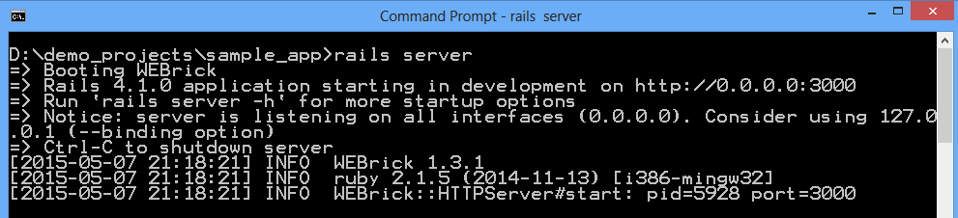
Running Rails Application
Rails application can be booted using the following command
>rails server
This command will fire up WEBrick, a web server distributed with Ruby.
Default environment is development
Default port is 3000
http://127.0.0.1:3000

Slide 19
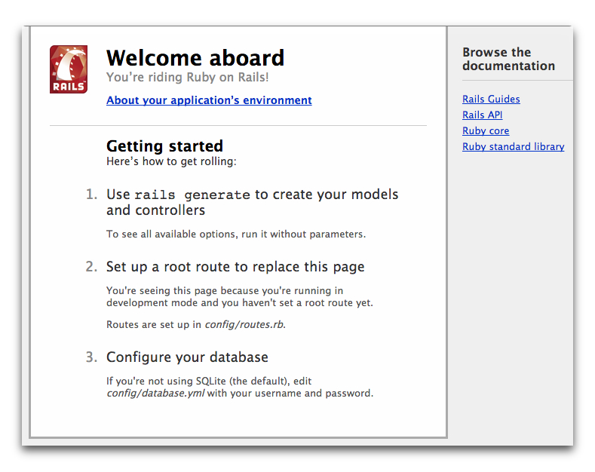
Running Rails Application (Contd.)
To see your application in action, open a browser window and navigate to http://localhost:3000

Slide 20

Demo on MVC in Rails

